Slide 1
Task 3
Vulnerabilities in the website: http://testasp.vulnweb.com/

Slide 2
Report
Title : Cross Site Scripting
--
Domain >> http://vulnweb.com/
Sub domain >> http://testasp.vulnweb.com/login
--
Linux 7.1, Wifi
--
Description : Cross site Scripting was found in the web application.
--

Slide 3
Report (cont.)
Steps to Reproduce:
Step 1: Visit http://testasp.vulnweb.com/
Step 2: On the top menu you will find a Register option.
Step 3: Now in the username section fill a XSS payloads(<script>alert(1)</script>).
Step 4: After successfully registering, click on Login.
Step 5: After login through the payload as username, it will give the alert(1) applet prompt up.
--

Slide 4
Report (cont.)
Impact : Any Black Hat Hacker can steel the private and confidential data of our users.
It can led to the security alert of our users who have full faith on us.
--
PoC : For Proof of Concept, the supporting documents are attached in the report.
Task 3(1).png
Task 3(2).png
Task 3(3).png
Task 3.mp4
--

Slide 5
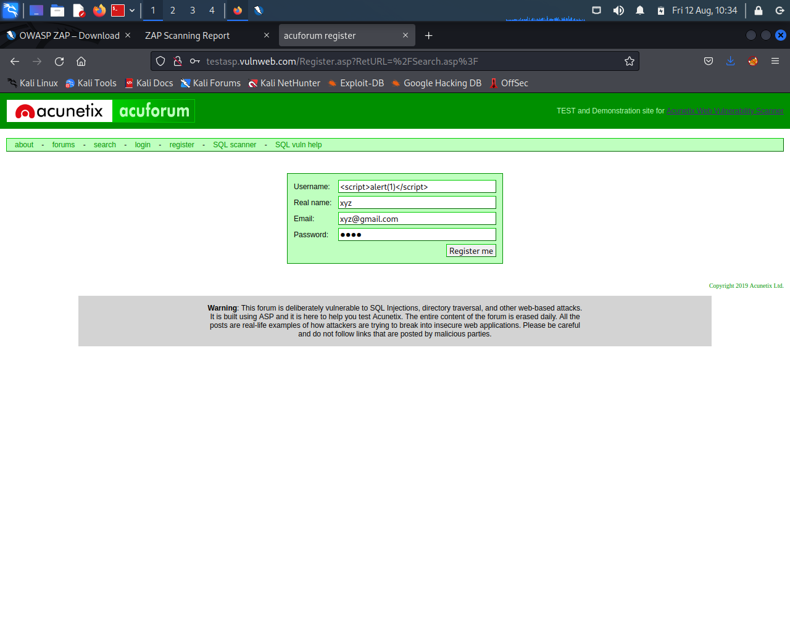
Task 3(1).png

Slide 6
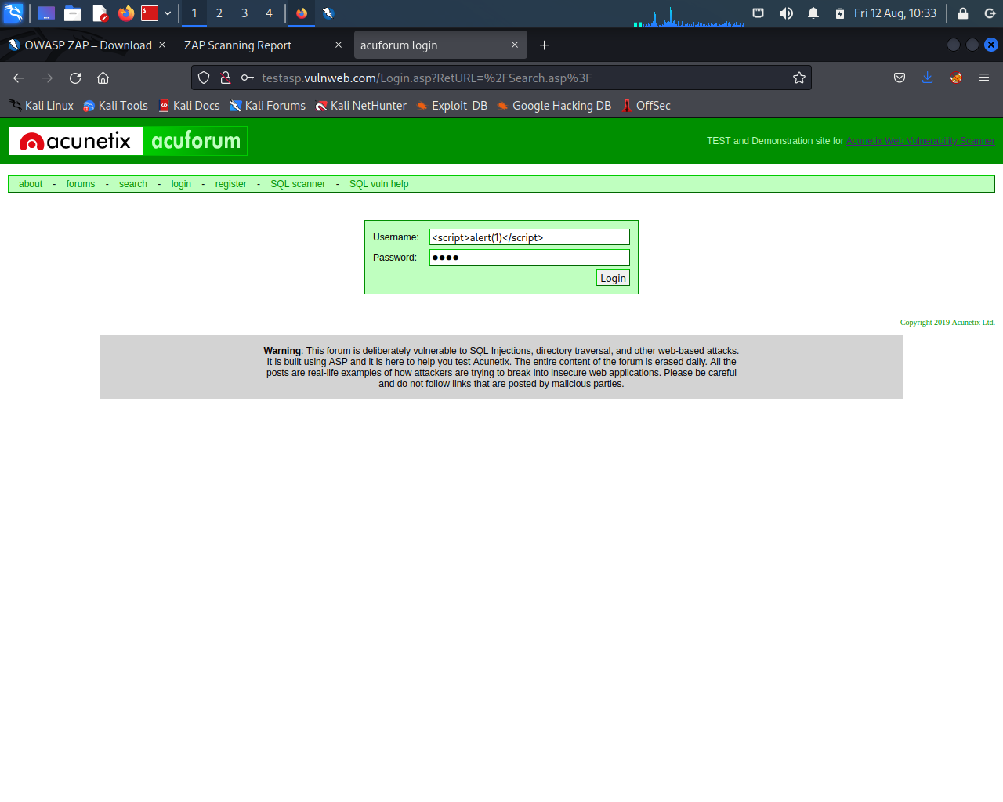
Task 3(2).png

Slide 7
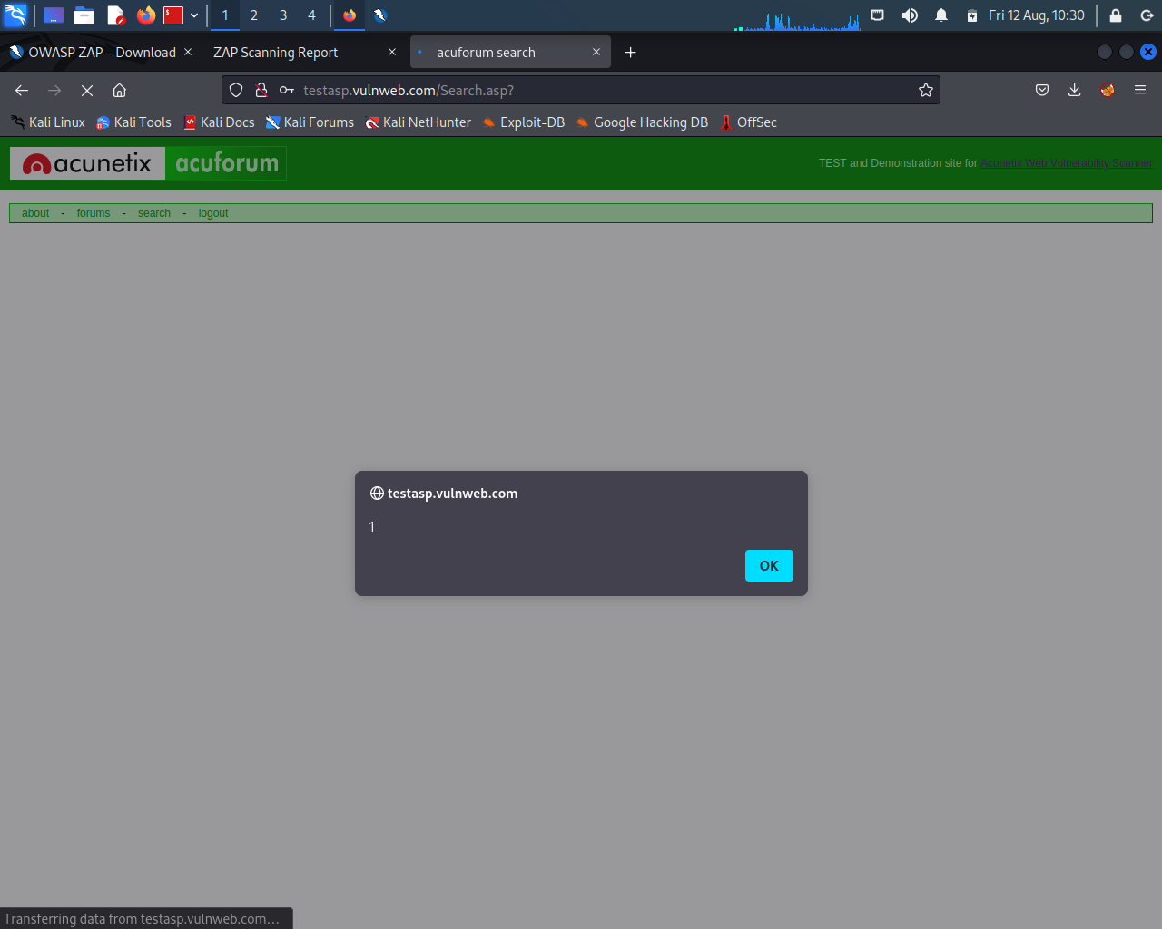
Task 3(3).png

Slide 8

Task 3.mp4

